Slide 1

Instagram User Analytics

Slide 2

Table of Contents
Project Overview
Marketing Analysis
Investor Metrics
How to do this Project?
Insights
Project Report

Slide 3

Project Overview
The purpose of this project is to leverage SQL and MySQL Workbench to analyze user interactions and engagement with the Instagram mobile application.
As a data analyst working closely with Instagram's product team, our objective is to extract valuable insights from the user data.
These insights will play a pivotal role in shaping the future direction of the Instagram app and ultimately contribute to the growth and success of the platform.

Slide 4
Approach
Our approach involves a structured analysis of Instagram user data using SQL techniques. We will follow these key steps to derive meaningful insights:
Data Extraction: We will access and extract relevant data from Instagram's databases, focusing on user engagement metrics, content types, and user demographics.
Data Analysis: Using SQL queries and MySQL Workbench, we will perform in-depth analysis to uncover patterns, trends, and correlations within the data.
Key Metrics: We will examine critical user engagement metrics, such as likes, comments, shares, and the timing of interactions.
Content Analysis: We will assess the popularity of different content types, including photos, videos, and stories, to understand user preferences.
Demographic Insights: We will explore user demographics, including age groups, geographical regions, and user-generated hashtags to gain a comprehensive understanding of our user base.

Slide 5


Tech-Stack Used
SOFTWARE: MYSQL AND MYSQL WORKBENCH
VERSIONS: MYSQL VERSION 8.0 AND MYSQL WORKBENCH VERSION 8.0

Slide 6
Reasons for Choosing MySQL and MySQL Workbench
Open-Source: MySQL is an open-source relational database management system. It is widely used, well-documented, and has an active user community. Being open-source, it aligns with cost-effective solutions for data analysis.
Compatibility: MySQL is a commonly used database system in various industries, making it an ideal choice for working with real-world datasets. It is also compatible with many programming languages and can be integrated seamlessly into applications.
SQL Capabilities: MySQL supports robust SQL capabilities, including complex queries, data manipulation, and aggregation functions. This is crucial for performing in-depth data analysis, which is a core component of this project.
MySQL Workbench: MySQL Workbench is a graphical tool that provides a user-friendly interface for working with MySQL databases. It streamlines tasks such as data extraction, query writing, and data visualization, making it an efficient choice for data analysts.
Community Support: MySQL has a large and active community of developers, data professionals, and users. This means that there is a wealth of online resources, forums, and tutorials available for troubleshooting and learning.
Scalability: MySQL is known for its scalability, which is important when dealing with large datasets. Instagram likely has a massive user base, and MySQL's ability to handle substantial data volumes is advantageous.

Slide 7
Insights
01
02
03
04
05
06
07
Loyal User Reward
Inactive User Engagement
Contest Winner Declaration
Hashtag Research
Ad Campaign Launch
User Engagement
Bots & Fake Accounts

Slide 8

Loyal User Award
Loyal User Reward: The marketing team wants to reward the most loyal users, i.e., those who have been using the platform for the longest time.
Identify the five oldest users on Instagram from the provided database.

Slide 9
Loyal User Award (SQL Query)
select * from users
order by created_at
limit 5;

Slide 10
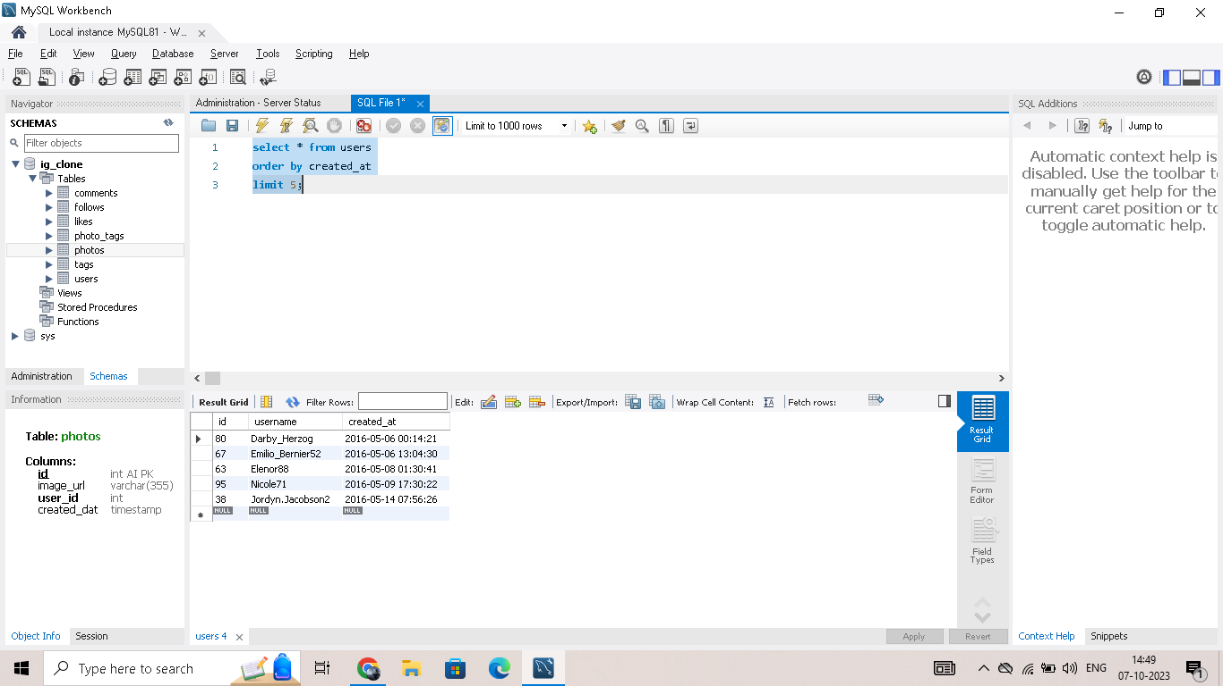

Slide 11

Inactive User Engagement
The team wants to encourage inactive users to start posting by sending them promotional emails.
Identify users who have never posted a single photo on Instagram.

Slide 12
Inactive User Engagement(SQL Query)
select * from users
left join photos
on
users.id = photos.user_id
where photos.id is null

Slide 13
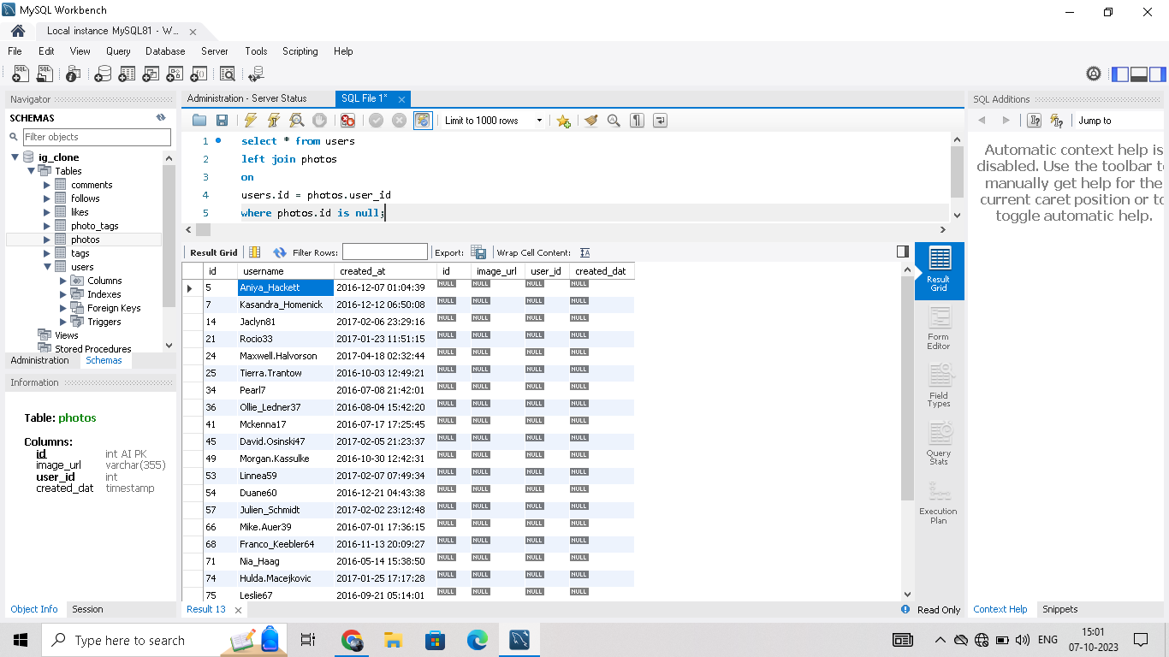

Slide 14

Contest Winner Declaration
The team has organized a contest where the user with the most likes on a single photo wins.
Determine the winner of the contest and provide their details to the team.

Slide 15
Contest Winner Declaration(SQL Query)
select distinct user_id, users.username, count(user_id) over(partition by user_id) as count_likes
from
likes
inner join users
on
users.id = likes.user_id order by count_likes desc;

Slide 16
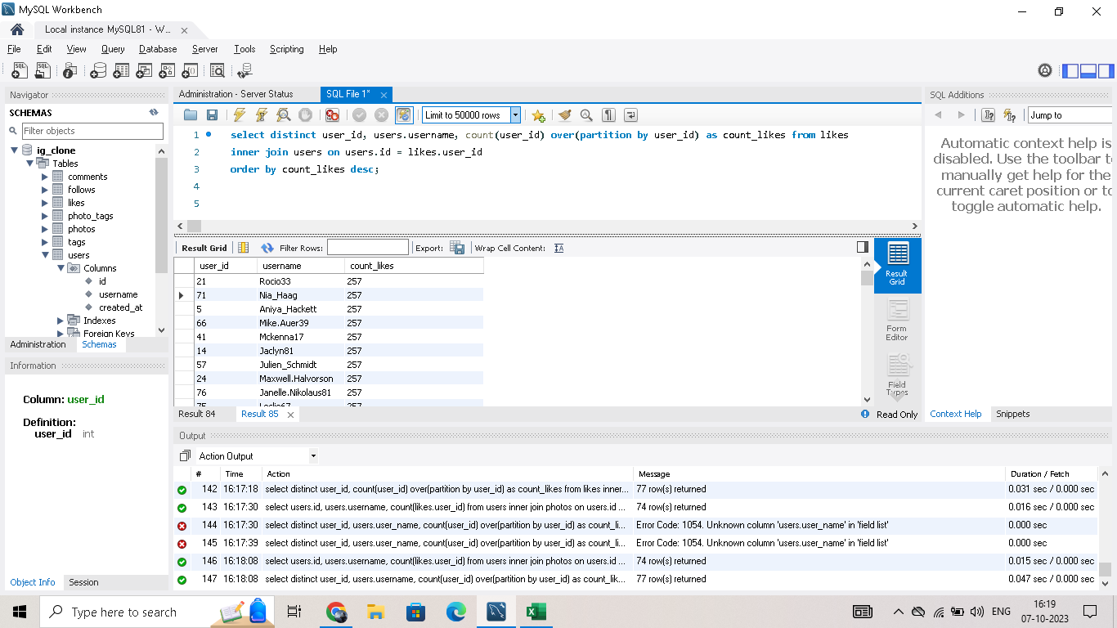

Slide 17


Hashtag Research
A PARTNER BRAND WANTS TO KNOW THE MOST POPULAR HASHTAGS TO USE IN THEIR POSTS TO REACH THE MOST PEOPLE.
IDENTIFY AND SUGGEST THE TOP FIVE MOST COMMONLY USED HASHTAGS ON THE PLATFORM.

Slide 18
Hashtag Research (SQL Query)
select tags.id, tags.tag_name, count(tag_name)
from tags
inner join
photo_tags
on
photo_tags.tag_id = tags.id
group by tags.id, tags.tag_name
order by count(tag_name) desc
limit 5;

Slide 19
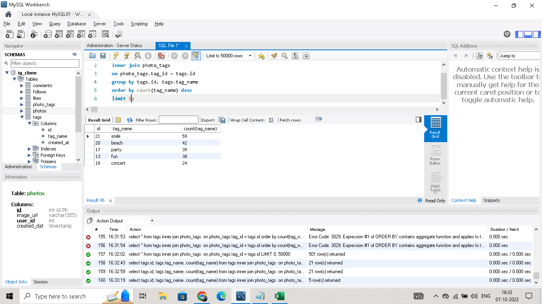

Slide 20

Ad Campaign Launch
- The team wants to know the best day of the week to launch ads.
- Determine the day of the week when most users register on Instagram.
- Provide insights on when to schedule an ad campaign.

Slide 21



Ad Campaign Launch (SQL Query)
select DAYOFWEEK(created_at), DAYNAME(created_at), COUNT(DAYNAME(created_at))
from users
group by DAYOFWEEK(created_at), DAYNAME(created_at)
order by COUNT(DAYNAME(created_at)) desc;

Slide 22
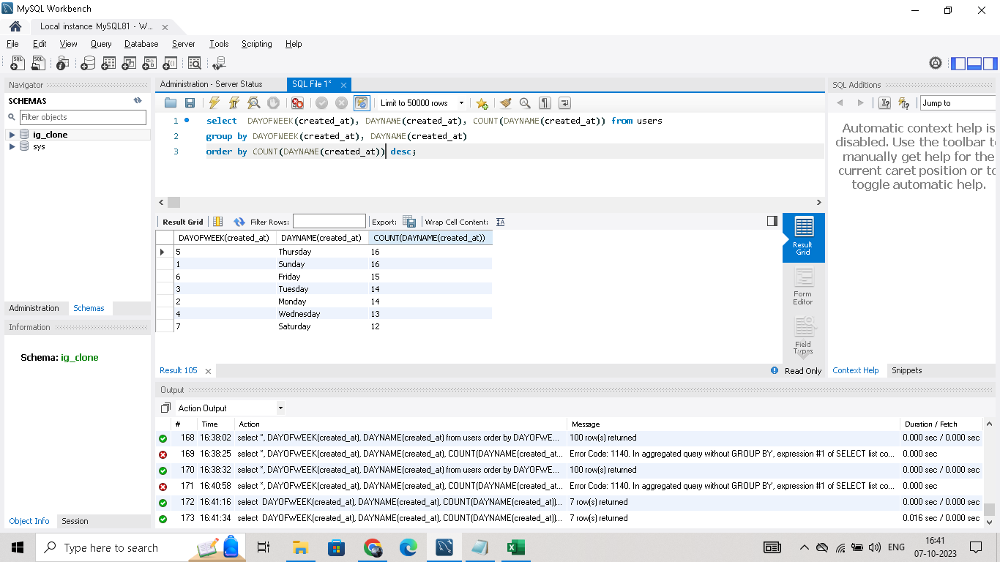

Slide 23

User Engagement
Investors want to know if users are still active and posting on Instagram or if they are making fewer posts.
Calculate the average number of posts per user on Instagram. Also, provide the total number of photos on Instagram divided by the total number of users.

Slide 24
User Engagement (SQL Query – 1)
select distinct username, user_id, count(user_id) over(partition by user_id) as avg_post_per_person from users
left join photos
on
users.id = photos.user_id
order by avg_post_per_person desc;

Slide 25
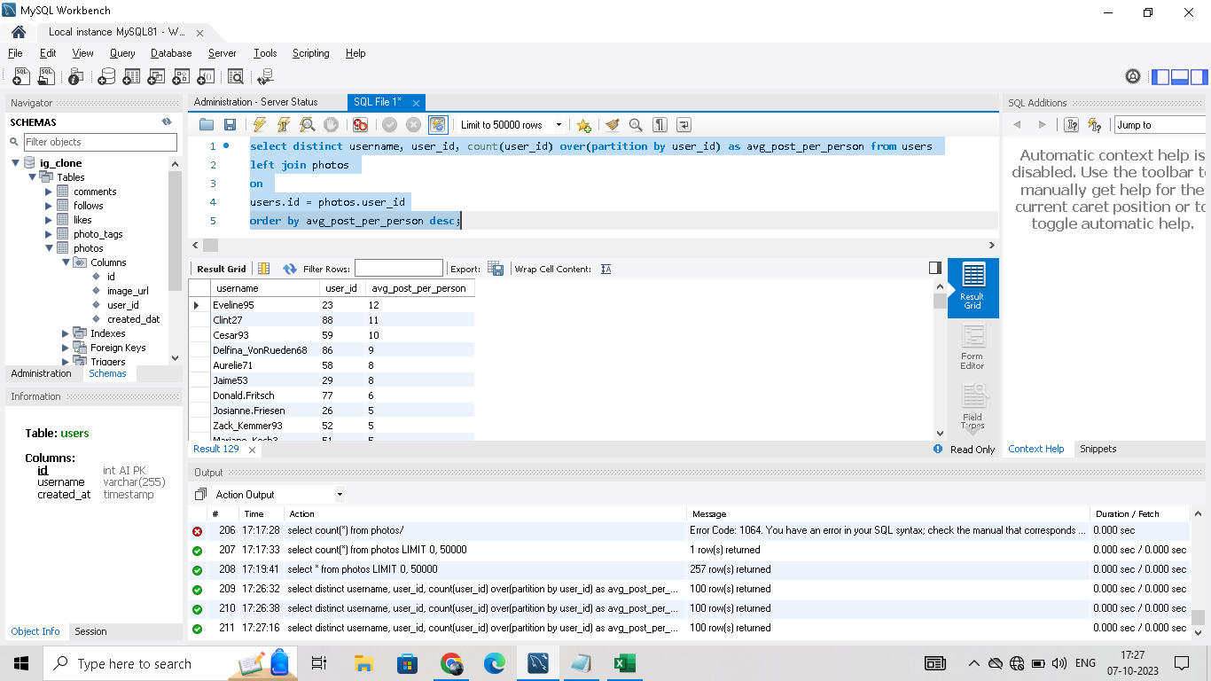

Slide 26
User Engagement (SQL Query – 2)
SELECT
(SELECT COUNT(*) FROM photos) AS total_photos,
(SELECT COUNT(*) FROM users) AS total_users,
(SELECT COUNT(*) FROM photos) / (SELECT COUNT(*) FROM users) AS photos_per_user_ratio;

Slide 27
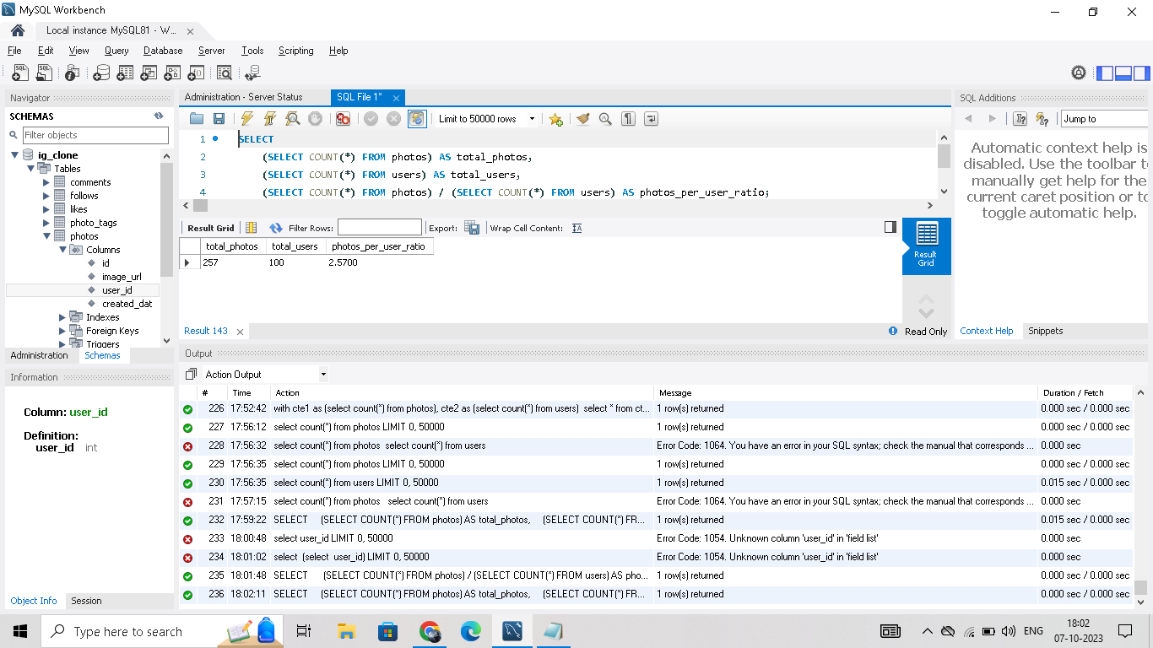

Slide 28
Bots & Fake Accounts
Investors want to know if the platform is crowded with fake and dummy accounts.
Identify users (potential bots) who have liked every single photo on the site, as this is not typically possible for a normal user.

Slide 29
Bots & Fake Accounts (SQL Query)
with cte1 as (select distinct user_id, count(*) over(partition by user_id) as like_count from likes as l) ,
cte2 as (select count(*) as total_photos from photos as p),
cte3 as (select * from cte1 where like_count in (select * from cte2)),
cte4 as (select users.id, users.username, cte3.like_count from users join cte3 on cte3.user_id = users.id)
select * from cte4

Slide 30
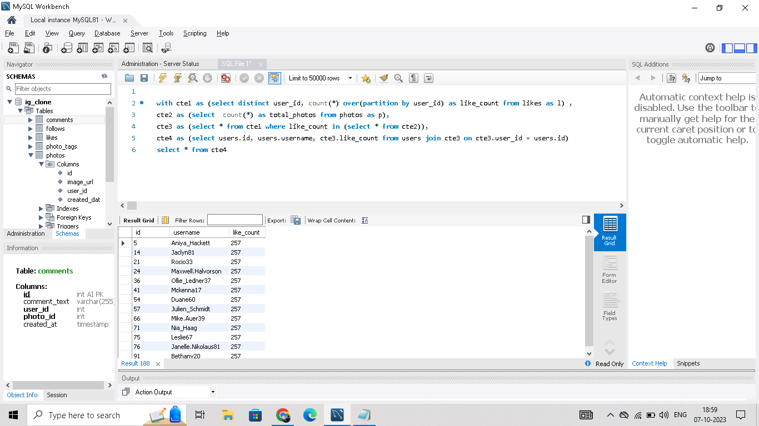

Slide 31



Project Achievements
In-Depth User Analysis: We conducted a comprehensive analysis of user interactions and engagement on Instagram. This included tracking likes, comments, shares, and user demographics.
Content Type Preferences: We identified user preferences for different content types, such as photos, videos, and stories, providing insights into the type of content that resonates most with users.
Timing Insights: We determined the most active times of day for user interactions, which can inform the scheduling of content posts and advertising campaigns.

Slide 32
Project Achievements
Demographic Understanding: We gained a deeper understanding of Instagram's user demographics, including age groups and geographical regions, which can be used for targeted marketing strategies.
User Behavior Patterns: By analyzing user-generated hashtags and patterns of engagement, we uncovered valuable insights into user behavior and interests.
Data-Driven Decision Support: The insights generated from the analysis can be used by various teams within Instagram, including marketing, product development, and app optimization, to make data-driven decisions.

Slide 33
Benefits and Impact
Informed Decision-Making: The insights derived from the analysis provide a data-driven foundation for decision-making. Teams at Instagram can now make informed choices regarding marketing strategies, product feature development, and user experience improvements.
Enhanced User Experience: By understanding user preferences and behaviors, Instagram can tailor its platform to better meet the needs of its diverse user base. This can lead to increased user satisfaction and retention.
Targeted Marketing: The demographic insights allow the marketing team to create more targeted and effective campaigns. This can result in improved engagement and conversion rates for advertisers on the platform.

Slide 34
Benefits and Impact
Competitive Edge: Instagram's ability to adapt and evolve based on user data insights gives it a competitive edge in the dynamic social media landscape. It ensures that the platform remains relevant and appealing to users.
Improved Product Development: Insights into user preferences can guide the development team in prioritizing features and functionalities that are in high demand, enhancing the overall user experience.
Optimized Content Strategy: Knowing the most active times for user interactions can help content creators and influencers schedule their posts for maximum engagement.

Slide 35

Conclusion
In conclusion, this project's achievements and insights have provided valuable information that can steer Instagram's growth and development. It underscores the power of data analysis in making informed decisions, improving user experiences, and maintaining competitiveness in the social media industry.

Slide 36
Thank You!

